Slide 1
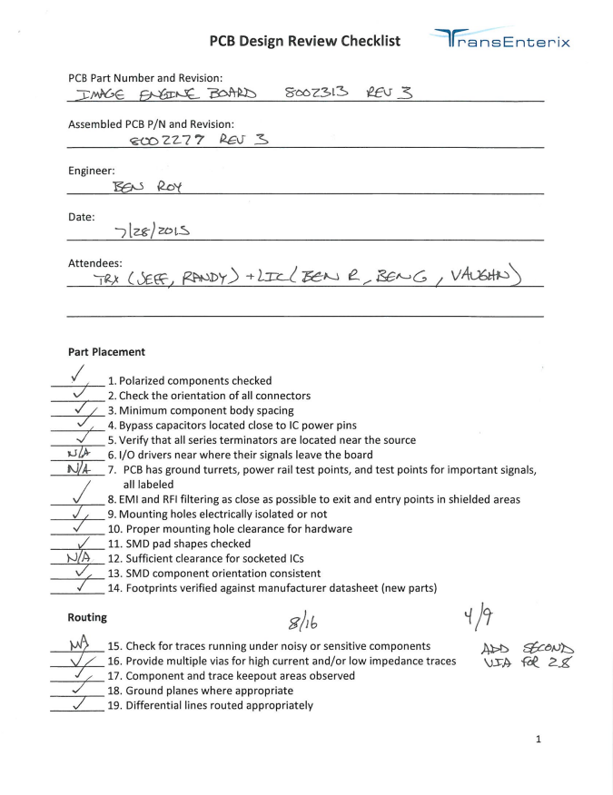

Slide 2
PCB DESIGN REVIEW CHECKLIST
PCB Part Number & Revision: Assembled PCB P/N and Revision:
Engineer: Date: Attendees:
Part Placement
1. Polarized components checked ☑ NA
2. Check the orientation of all connectors
3. Minimum component body spacing
4. Bypass capacitors located close to IC power pins
5. Verify that all series terminators are located near the source
6.1/0 drivers near where their signals leave the board NA ☑
7. PCB has ground turrets, power rail test points, and test points for important signals, all labeled
8. EMI and RFI filtering as close as possible to exit and entry points in shielded areas
9. Mounting holes electrically isolated or not ☑
10. Proper mounting hole clearance for hardware ✓
11. SMD pad shapes checked NAN/A
12. Sufficient clearance for socketed ICs
13. SMD component orientation consistent Routing
14. Footprints verified against manufacturer datasheet (new parts) 8/16 MA
15. Check for traces running under noisy or sensitive components ✓✓
16.Provide multiple vias for high current and/or low impedance traces 4/9

